Slide 1



Iot design methodology
201806100110072 (Asif Ahmed)
201806100110085 (Mihir Prajapati)
201806100110087 (Yagnesh Mistry)
201806100110114 (Raj ZALAVADIYA)

Slide 2
Outline
IoT Design Methodology that includes :
Purpose & Requirement Specification
Process Specification
Domain Model Specification
Information Model Specification
Service Specification
Iot Level Specification
Functional View Specification
Operational View Specification
Device & Component Integration
Application Development

Slide 3
Iot Level specification
IoT Level-1
A level-1 IoT system has a single node/device that performs sensing and/or actuation, stores data, performs analysis and hosts the application
Level-1 IoT systems are suitable for modeling low- cost and low-complexity solutions where the data involved is not big and the analysis requirements are not computationally intensive.

Slide 4
Continue…
IoT Level-2
A level-2 IoT system has a single node that performs sensing and/or actuation and local analysis.
Data is stored in the cloud and application is usually cloud- based.
Level-2 IoT systems are suitable for solutions where the data involved is big, however, the primary analysis requirement is not computationally intensive and can be done locally itself.

Slide 5
Continue…
IoT Level-3
A level-3 IoT system has a single node. Data is stored and analyzed in the cloud and application is cloud- based.
Level-3 IoT systems are suitable for solutions where the data involved is big and the analysis requirements are computationally intensive.

Slide 6
Continue…
IoT Level-4
A level-4 IoT system has multiple nodes that perform local analysis. Data is stored in the cloud and application is cloud-based.
Level-4 contains local and cloud- based observer nodes which can subscribe to and receive information collected in the cloud from IoT devices.
Level-4 IoT systems are suitable for solutions where multiple nodes are required, the data involved is big and the analysis requirements are computationally intensive.

Slide 7
Continue…
IoT Level-5
A level-5 IoT system has multiple end nodes and one coordinator node.
The end nodes that perform sensing and/or actuation.
Coordinator node collects data from the end nodes and sends to the cloud.
Data is stored and analyzed in the cloud and application is cloud-based.
Level-5 IoT systems are suitable for solutions based on wireless sensor networks, in which the data involved is big and the analysis requirements are computationally intensive.

Slide 8
Continue…
IoT Level-6
A level-6 IoT system has multiple independent end nodes that perform sensing and/or actuation and send data to the cloud.
Data is stored in the cloud and application is cloud-based.
The analytics component analyzes the data and stores the results in the cloud database.
The results are visualized with the cloud-based application.
The centralized controller is aware of the status of all the end nodes and sends control commands to the nodes.

Slide 9
Functional view specification
The Functional View Specification(FV) defines the functions of the IoT systems grouped into various Functional Groups(FGs).
Each functional group either provides functionalities for interacting with instances of concepts defined in the Domain Model or provides information related to these concepts.

Slide 10
Continue…
The Functional Groups(FGs) included in a Functional View included:
Device : The device FG contains devices for monitoring and control.
Communication : The communication FG handles the communication for IoT system. The communication includes the communication protocols that form the backbone of IoT systems and enable network connectivity.
The communication FG also includes the communication APIs that are used by the services and applications to exchange data over the network.

Slide 11
Continue…
Services : The service FG includes various services involved in the IoT system such as services for device monitoring, device control services, data publishing services and services for device discovery.
Management : The management FG includes all functionalities that are needed to configure and manage the IoT system.
Security : The security FG includes security mechanisms for the IoT system such as authentication, authorization, data security, etc.

Slide 12
Continue…
Application : The application FG includes applications that provide an interface to the users to control and monitor various aspects of the IoT system.
Applications also allow users to view the system status and the processed data.

Slide 13
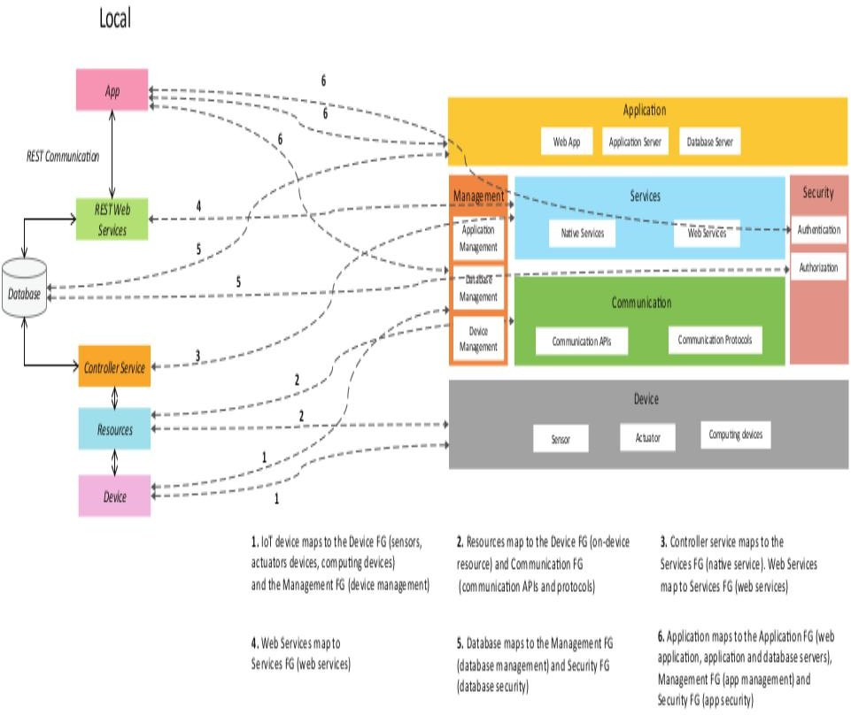
Continue…

Slide 14
Operational view specification
In this step, various options pertaining to the IoT system deployment and operation are defined, such as, service hosting options, storage options, device options, application hosting options, etc.

Slide 15
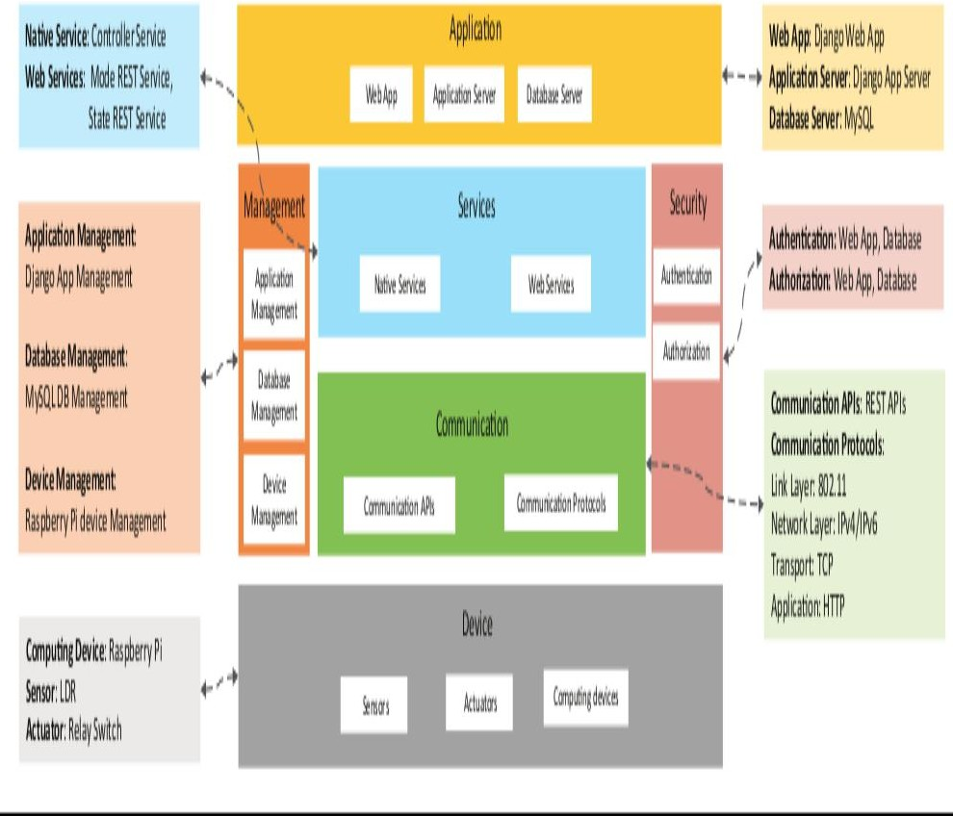
Continue…

Slide 16
Device & component integration
In this step design methodology is the integration of the devices and components.

Slide 17
Application development
In this step develop the IoT application for perform various task.

Slide 18
Any Questions ?

